Slide 1


PANIMALAR ENGINEERING COLLEGE
Department of Computer Science and Engineering
CS8811 PROJECT WORK
DROWSINESS MONITORING AND STREAMING SYSTEM USING LANDMARK DETUCTION AND KNN
Team Members with Register Number
Project Guide -
Mr.M.Krishnamoorthy,ME,MBA, (Ph.D)
VENKATESH PRASAD.S - 211419104299
VASANTHA KUMAR.R - 211419104297
ROHITH.T - 211419104224
Batch Number -
C8

Slide 2
INTRODUCTION
Many road accidents which lead to death are because of drowsiness while driving. Drivers who drive long hours like truck drivers, bus drivers are likely to experience this problem. It is highly risky to drive with lack of sleep and driving for long hours will be more tiresome. Due to the drowsiness of the driver causes very dangerous consequences, it is estimated that 70,000 to 80,000 injures & crashes happen worldwide in a year. Even deaths have reached 1000-2000 every year. There are many unofficial deaths which are not confirmed by drivers that it was due to their drowsiness. This takes lives of many innocent people. It is a nightmare for a lot of people who travel across world. It is very important to identify the driver drowsiness and alert the driver to prevent crash.
The goal of this research is the detection of the indication of this fatigue of the driver. The acquisition system, processing system and warning system are the three blocks that are present in the detection system. The video of the driver’s front face is captured by the acquisition system and it is transferred to the next stage i.e., processing block. The detection is processed if drowsiness of driver is detected, then the warning system gives a warning or alarm.
The methods to detect the drowsiness of the drive may be done using intrusive or nonintrusive method i.e., with and without the use of sensors connected to the driver. The cost of the system depends on the sensors used in the system. Addition of more parameters can increase the accuracy of the system to some extent. The motivation for the development of cost effective, and real-time driver drowsiness system with acceptable accuracy are the motivational factors of this work. Hence, the proposed system detects the fatigue of the driver from the facial images, and image processing technology and machine learning method are used to achieve a cost effective and portable system.

Slide 3
LITERATURE SURVEY
Title | Author | Year of publication | Modules
Drowsiness Detection System Utilizing Physiological Signals | Trupti K. Dange | 2022 | 1.EEG-BASED DRIVER FATIGUE DETECTION 2. WAVELET ANALYSIS OF HEART RATE VARIABILITY & SVM CLASSIFIER 3. PULSE SENSOR METHOD 4. WEARABLE DRIVER DROWSINESS DETECTION SYSTEM
Drowsiness Detection with OpenCV (Using Eye Aspect Ratio) | Adrian Rosebrock | 2021 | EAR SVM Eye blink detection
Real Time Driver Fatigue Detection Based on SVM Algorithm | Burcu Kir Savas | 2020 | Fatigue detection SVM Driving safety Video processing

Slide 4
PROBLEM STATEMENT
Traffic accidents due to human errors cause many deaths and injuries around the world. The major cause of these accidents is drowsiness of the driver due to sleeplessness or long driving hours. There is need for a system developed with the technologies that are available today which can overcome this situation. The aim of this system is to reduce the number of accidents by developing a model which can generate an alert if the driver is feeling drowsy so that the driver can become aware and take necessary actions

Slide 5
TECHNOLOGY STACK
SOFTWARE REQUIREMENTS
Operating System : Windows
Tool : Python, C, Open CV, Tensor Flow, D-lib
HARDWARE REQUIREMENTS
Hard disk : minimum 80 GB
RAM : minimum 2 GB
Basic spec sensor (camera)

Slide 6
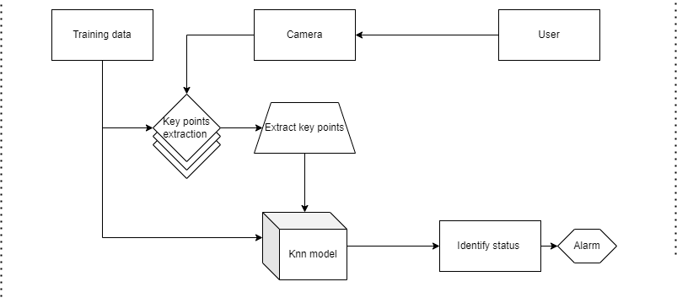
SYSTEM ARCHITECTURE
1. ER diagram

Slide 7
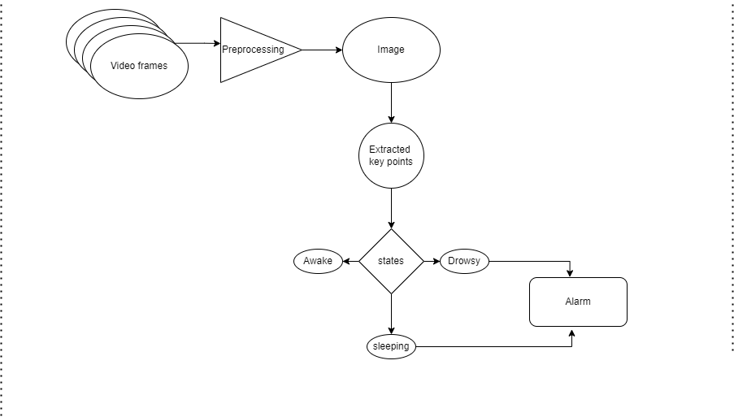
2. DATAFLOW DIAGRAM

Slide 8
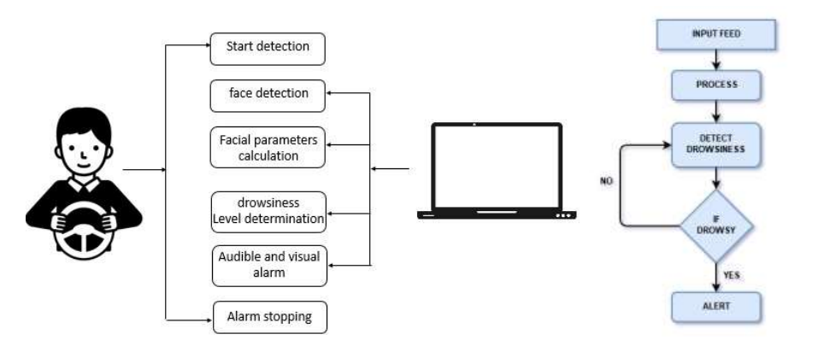
3. USE CASE DIAGRAM

Slide 9
MODULE DESCRIPTION: Module -1 Video Capture:
Python provides various libraries for image and video processing.
One of them is OpenCV. OpenCV is a vast library that helps in providing various functions for image and video operations.
With OpenCV, we can capture a video from the camera.
It lets you create a video capture object which is helpful to capture videos through webcam and then you may perform desired operations on that video..

Slide 10
Module - 2
Deduction
1. Face Detection
2. Feature Detection
3. Drowsy State Identification
4. Alert System
Face Detection: The working of our application starts with the recording of the driver. Detecting the face of the subject is our priority as this greatly affects the later process. Face detection is considered to be the first module that is implemented using the HOG algorithm. HOG is the short form for Histogram of Oriented Gradients, it is a feature descriptor that is used to identify the object as it is explained in the above chapter. So, HOG is used as an image descriptor in our application

Slide 11
Feature Detection: As we already mentioned that our application is based on behavioral characteristics, so features status are used to state whether the driver is drowsy or not. Feature detection is the module where we use our second algorithm, SVM. SVM stands for Support Vector Machine which is a classification algorithm used to detect features on the subjects face accurately using facial landmarks. This module is implemented on every frame which is outputted from the previous module.
Drowsy state identification: This is the module where the calculations and comparisons are done on the results of the previous module. As we said the eyes and mouth status are taken into consideration in concluding whether the subject is fatigue. Two operations are carried out in this module which are described below.
Calculation: In detecting a drowsy state we calculate the aspect ratio of the eyes and mouth. Since the aspect ratio is calculated separately for each eye, we take an average of the values of both eyes.
Comparison: The calculated aspect ratio values are compared with the threshold to decide the status of the driver. The threshold values are given to the system or we can say they are taken by default. The calculated aspect ratio of the eye has to be greater than the threshold if not the application considers that the driver is drowsy. It is reverse in the case of mouth, the calculated aspect ratio of the mouth should be less than the threshold if not the application considers that the driver is yawning.
Alert system: This is the module of various options. Alerting the driver is our intention in this module. Alerting the subject can be achieved in many ways from sending a message to taking control of the car. Our system alters the driver by an alarm sound.

Slide 12
Module - 3
Key point Extraction
This is considered the first step towards data splitting and processing. The reference images in Figure 3 and Figure 4 are used to obtain the coordinates of the land markings.
These features are then localised and extracted to minimise the maximum background noise.
Basic features extracted are nose, eyes, mouth, eyebrows, and jawline. These facial landmarks extracted can be used in many applications like an alignment of the face, swapping of faces, e.g., Snapchat, and other applications like blinking detection.
These facial landmarks extracted can be used in many applications like the alignment of the face, swapping of faces like in applications like Snapchat, and other applications like blinking detection.

Slide 13
Module 4
Blinking and Sleeping Classification
The eye-blinking frequency is an indicator that allows a driver’s drowsiness (fatigue) level to be measured. As in the works of Horng et al. and Dong and Wu, if five consecutive frames or during 0.25 s are identified as eye-closed the system is able to issue an alarm cue; PERCLOS also is implemented in this system. Presents an instantaneous result of this system over a driver’s image, whereas pictures the evolution drowsiness index graph for a driver’s drowsiness sequenTo identify drowsiness through eye analysis it is necessary to know its state: open or closed, through the time and develop an analysis over time, i.e., to measure the time that has been spent in each state. Classification of the open and closed state is complex due to the changing shape of the eye, among other factors, the changing position and the rotating of the face, and variations of twinkling and illumination. All this makes it difficult to analyze eye in a reliable manner. For the problems that have been exposed a supervised classification method has been used for this challenging task, in this case, a support vector machine (SVM).

Slide 14
Module 5
Output Displaying
The output will be displayed as sleeping when the eyes are in closed state for certain period of time, it will be displayed drowsy when the eyes are partially closed state and it will displayed active when the eyes are in open.

Slide 15
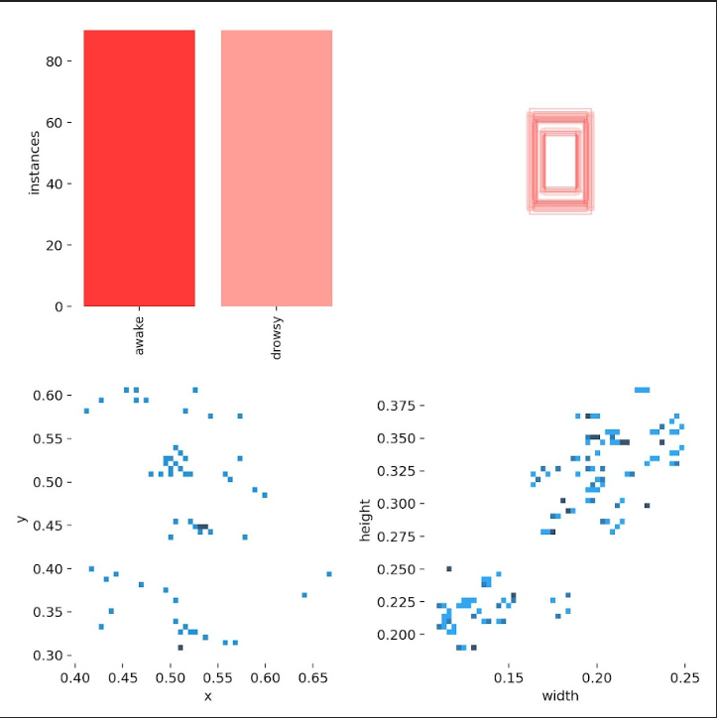
Dataset distribution

Slide 16
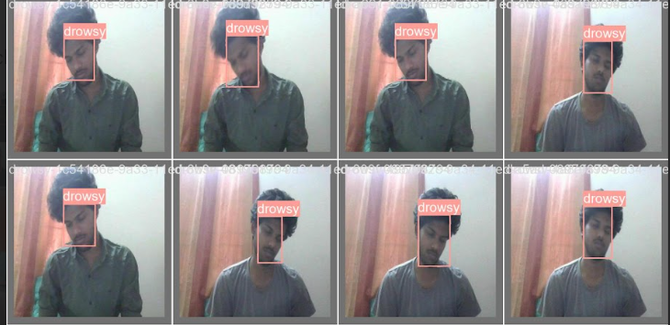
OUTPUT SCREENSHOTS
Drowsy state

Slide 17
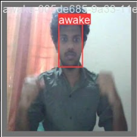
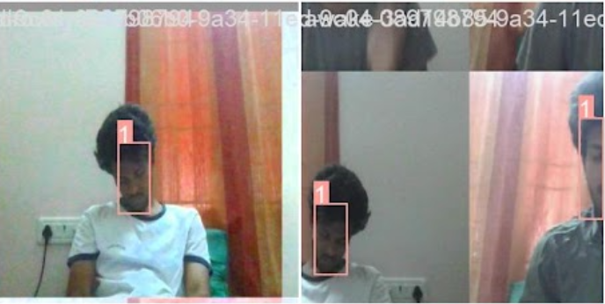
Active or Awake State
Sleeping or Alert State

Slide 18
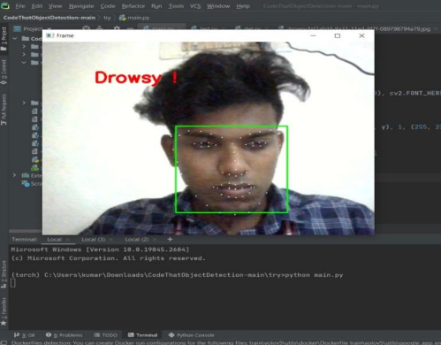
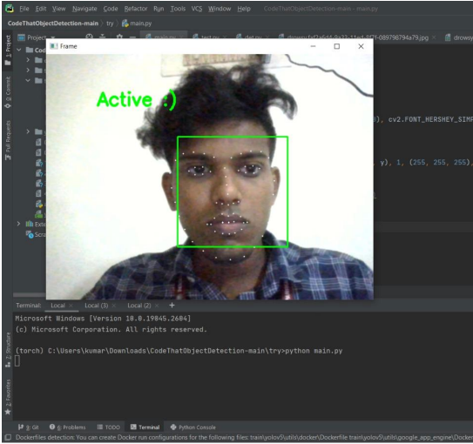

Slide 19
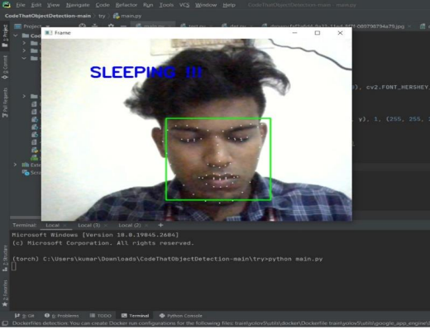

Slide 20
CONCLUSION
In this paper, a research project to develop a non-intrusive driver’s drowsiness system based on Computer Vision and Artificial Intelligence has been presented. This system uses advanced technologies for analyzing and monitoring drivers eye state in real-time and in real driving conditions.
The proposed algorithm for face tracking, eye detection and eye tracking is robust and accurate under varying light, external illuminations interference, vibrations, changing background and facial orientations
For future work, the objective will be to reduce the percentage error, i.e., to reduce the false alarms; for this, extra experiments will be developed, using additional drivers and incorporating new modules.

Slide 21
REFERENCES
Armingol, J.M., de la Escalera, A., Hilario, C., Collado, J., Carrasco, J., Flores, M., Pastor, J., Rodriguez, F.: IVVI: intelligent vehicle based on visual information. Robot. Auton. Syst. 55, 904–916 (2020). doi:10.1016/j.robot.2020.09.004
Bergasa, L., Nuevo, J., Sotelo, M., Vazquez, M.: Real time system for monitoring driver vigilance. In: IEEE Intelligent Vehicles Symposium, Parma, 14–17 June 2021
Brookshear, J.G.: Theory of Computation: Formal Languages, Automata and Complexity. Addison Wesley Iberoamericana, Reading (2021)
Brandt, T., Stemmer, R., Mertsching, B., Rakotomirainy, A.: Affordable visual driver monitoring system for fatigue and monotony. IEEE Int. Conf. Syst. Man Cybern. 7, 6451–6456 (2019)
Branzan, A., Widsten, B., Wang, T., Lan, J., Mah, J.: A computer vision-based system for realtime detection of sleep onset in fatigued drivers. In: IEEE Intelligent Vehicles Symposium, pp. 25–30 (2020)

